Slide 1

Swin Transformer: Hierarchical Vision Transformer using Shifted Windows
Ze Liu† Yutong Lin Yue Cao Han Hu Yixuan Wei Zheng Zhang Stephen Lin Baining Guo Microsoft Research Asia

Slide 2
This paper presents a new vision Transformer, called Swin Transformer, that capably serves as a general-purpose backbone for computer vision.
Challenges in adapting Transformer from language to vision arise from differences between the two domains, such as large variations in the scale of visual entities and the high resolution of pixels in images compared to words in text.
In existing Transformer-based models, tokens are all of a fixed scale, a property unsuitable for these vision applications. Another difference is the much higher resolution of pixels in images com pared to words in passages of text.

Slide 3
Self-Attention for NLP
I decided to deposit some money in the bank and take a stroll along the river bank to enjoy the view.

Slide 4
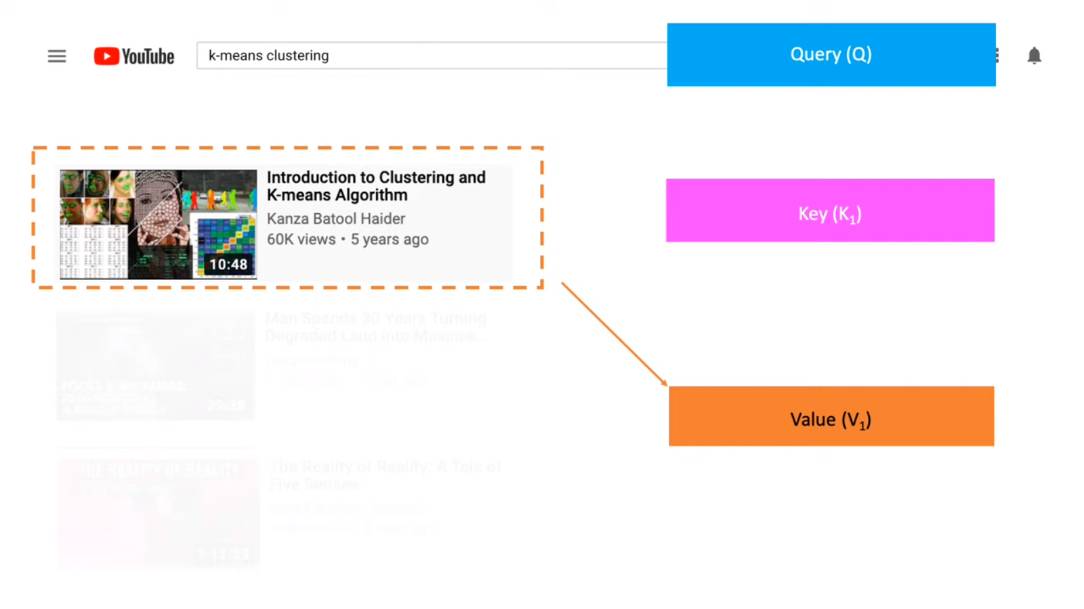
Queries(Q) - The queries are used to determine how much attention each input element (key) should receive when generating the output.
Keys – Key vectors help establish relationships between different positions in the sequence. The attention mechanism computes the similarity between the queries and the key vectors to determine how relevant each key is to the current query.
Values – Values are associated with the key vectors and represent the information or content that the model wants to retrieve or emphasize. The values are used to calculate the weighted average of the values based on the computed attention scores between queries and keys.

Slide 5
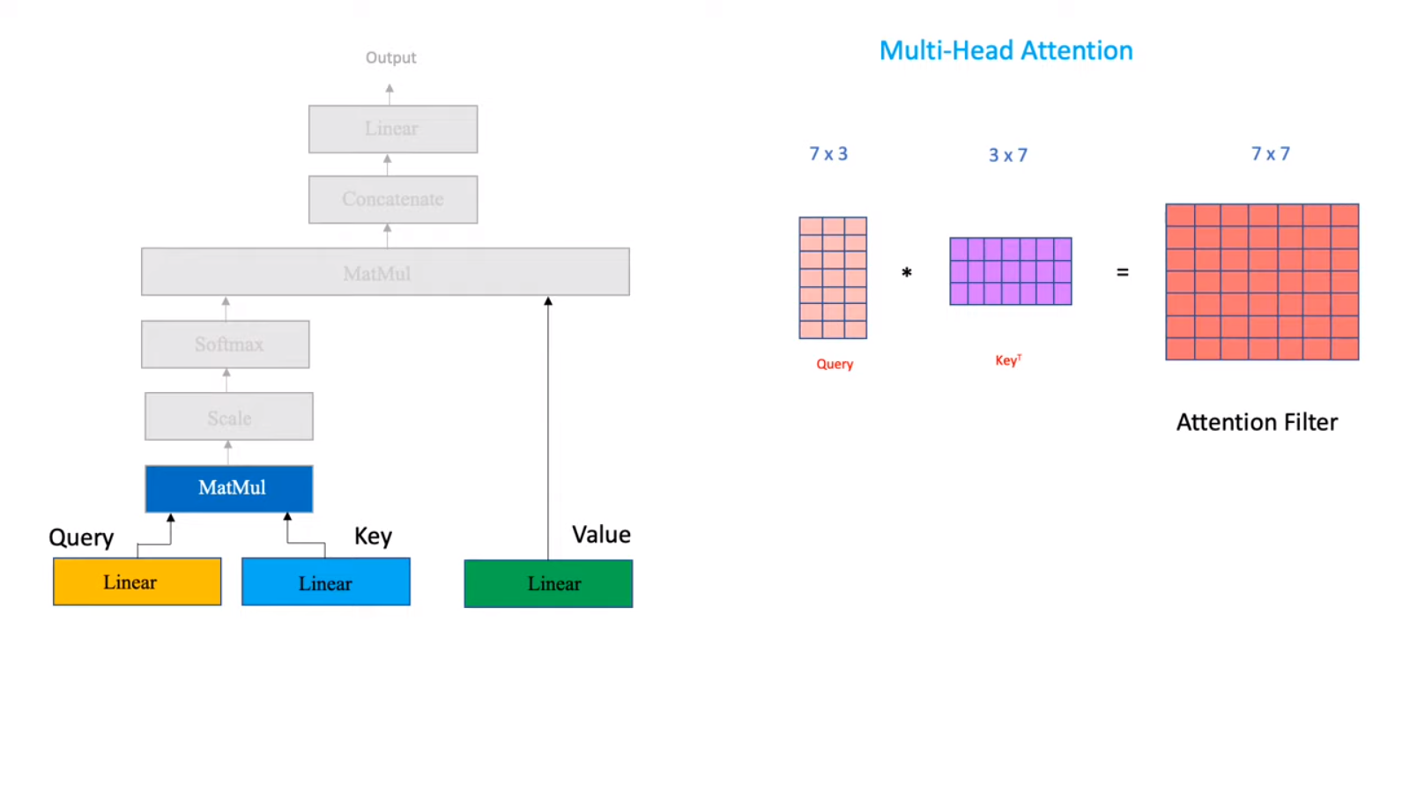
Compute Attention Filter

Slide 6
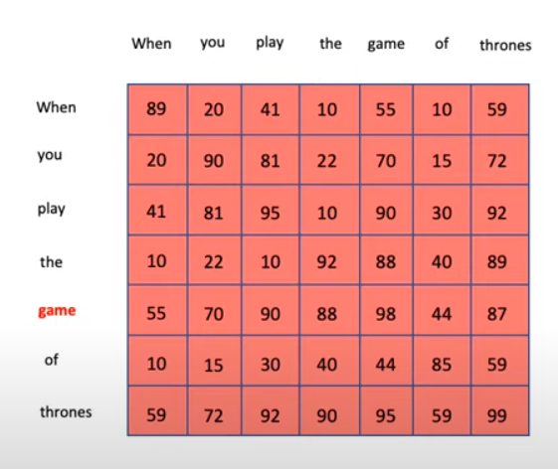
Attention table
After calculating the values from the table -> we scale the values

Slide 7
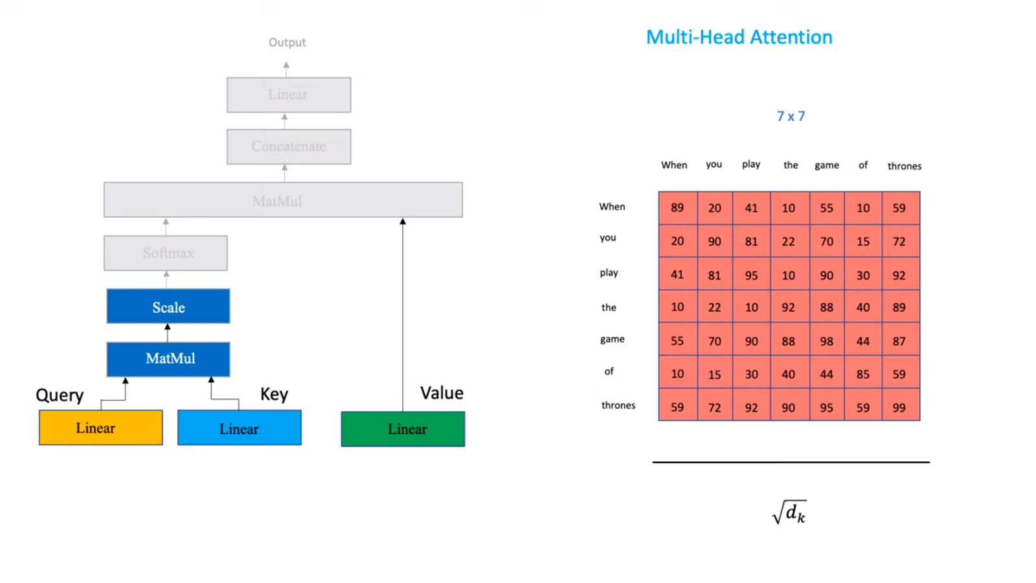
Scaling attention score

Slide 8
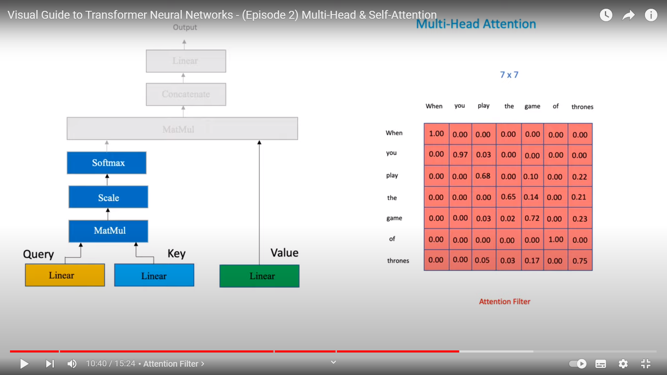
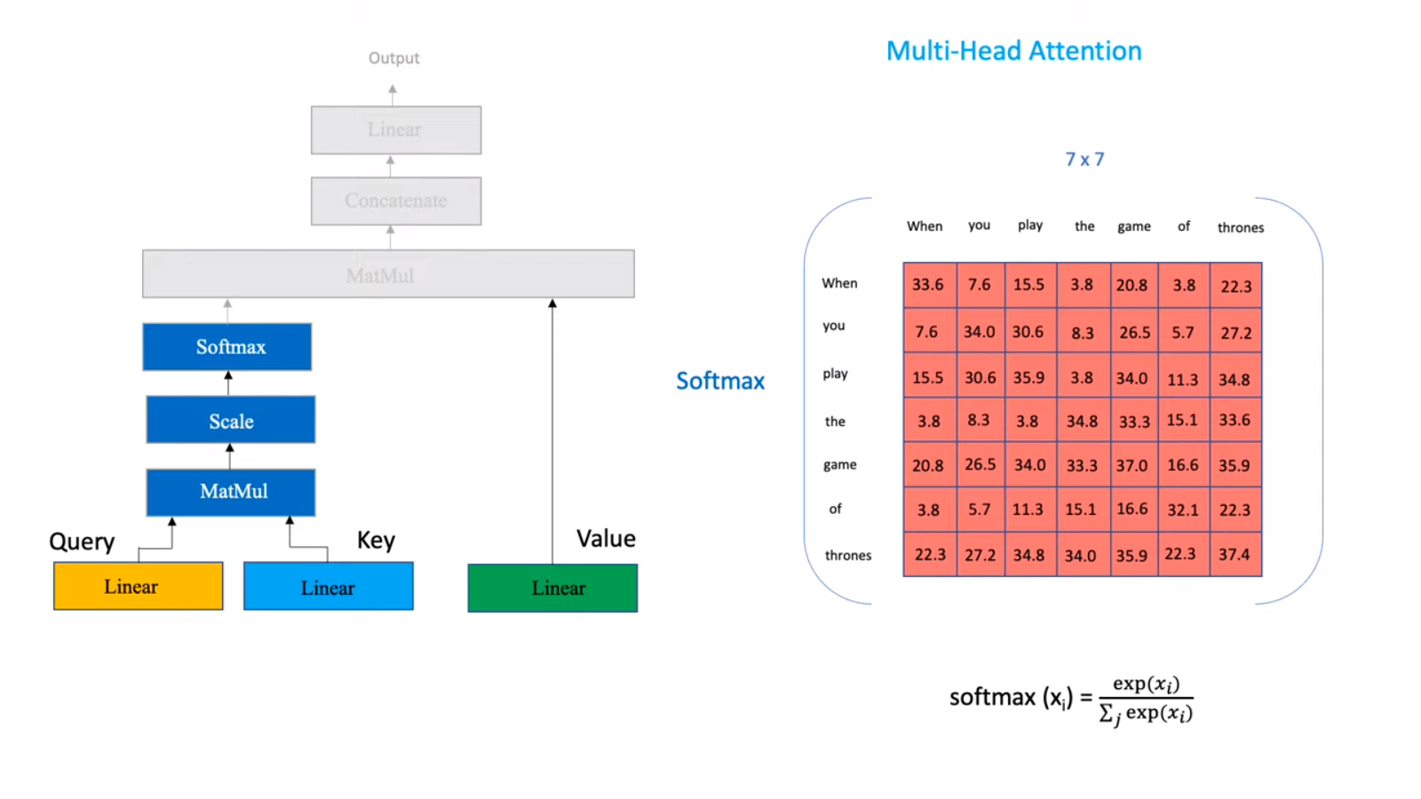
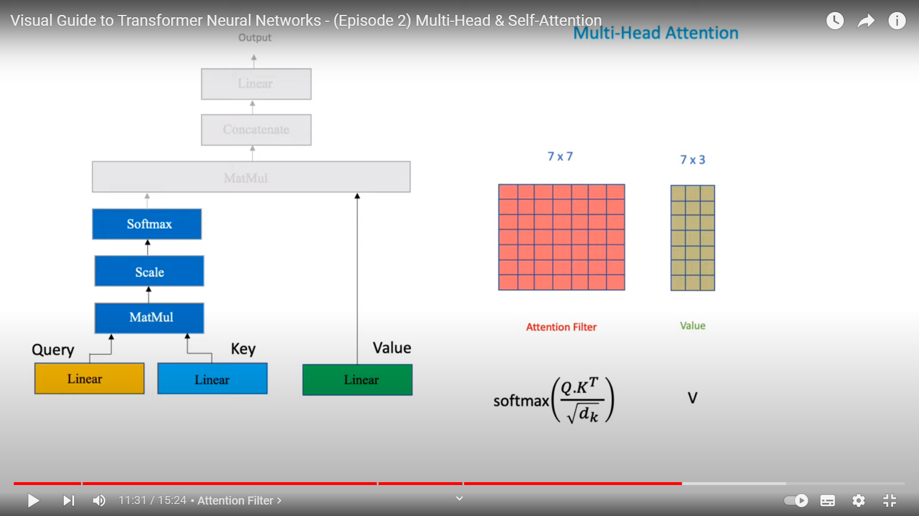
Apply Softmax filter

Slide 9
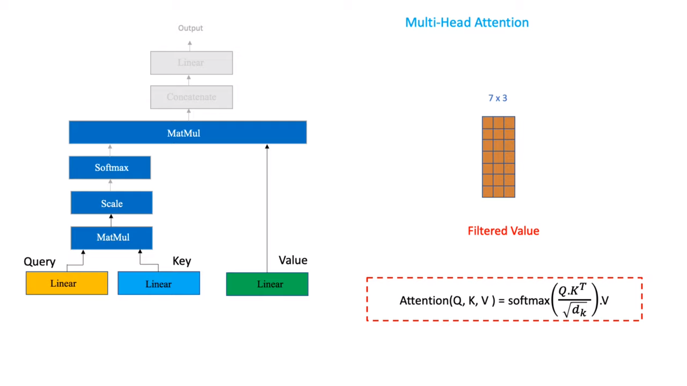

Slide 10
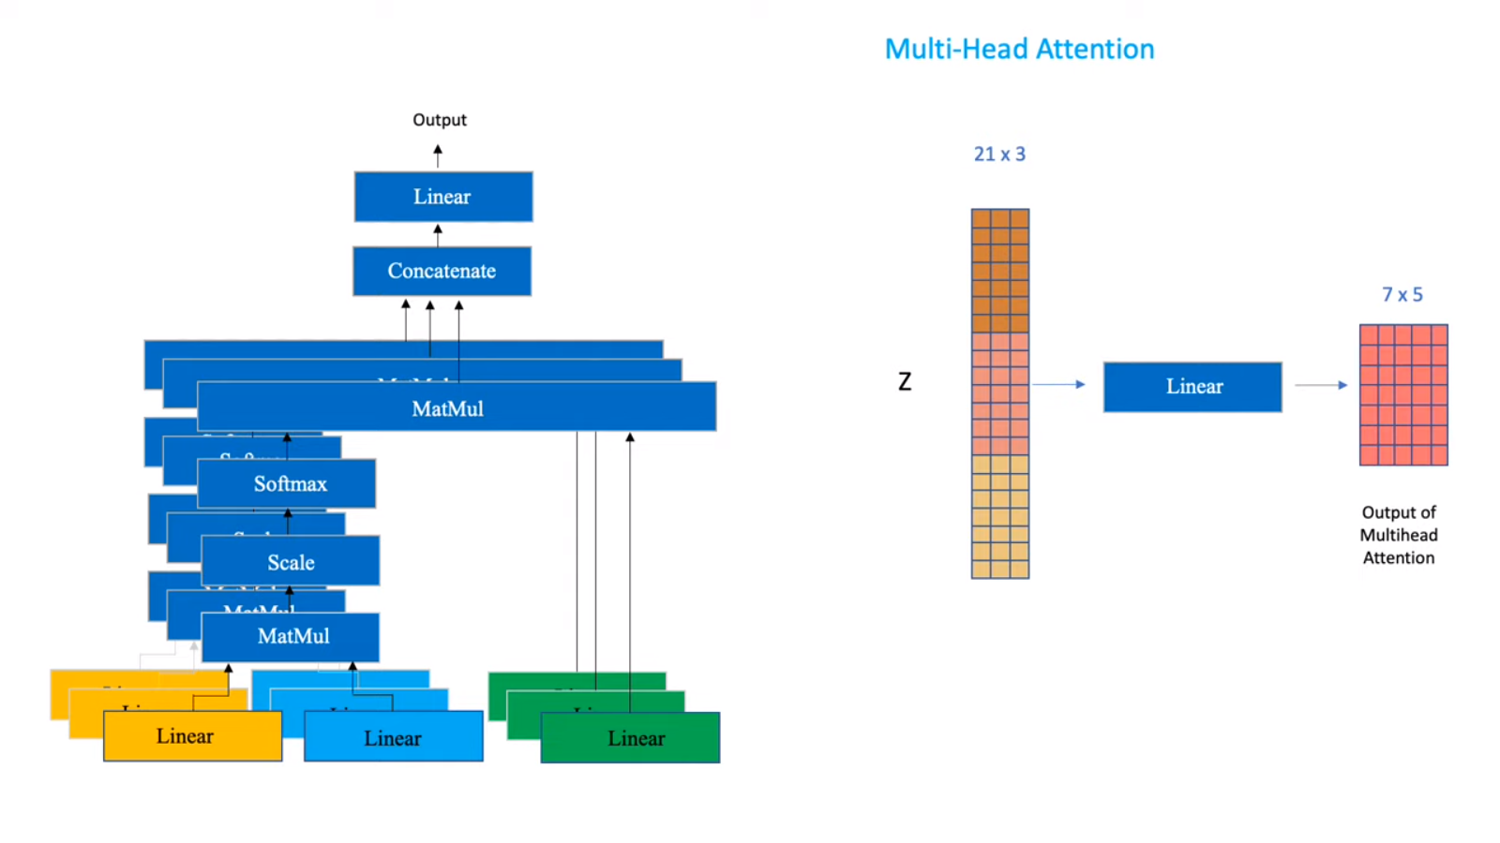
Concatenate -> Linear -> Output

Slide 11

ViT (Vision Transformer)
Beats CNN’s(by a small margin) if the dataset for pretraing is sufficienly large(at least 100 million images).
Studied in [Submitted on 22 Oct 2020 (v1), last revised 3 Jun 2021 (this version, v2)] An Image is Worth 16x16 Words: Transformers for Image Recognition at Scale

Slide 12
Steps of ViT
Patching: the image is divided into fixed-size patches, each of these patches is then linearly embedded into a flat vector.
Positional Encoding: Positional embeddings are added to the patch embeddings to provide some spatial context
Transformer Encoder
Classification Head: For tasks like image classification, a special 'classification token' is prepended to the sequence of embedded patches.
Training and Data Augmentation: ViT benefits from larger datasets

Slide 13
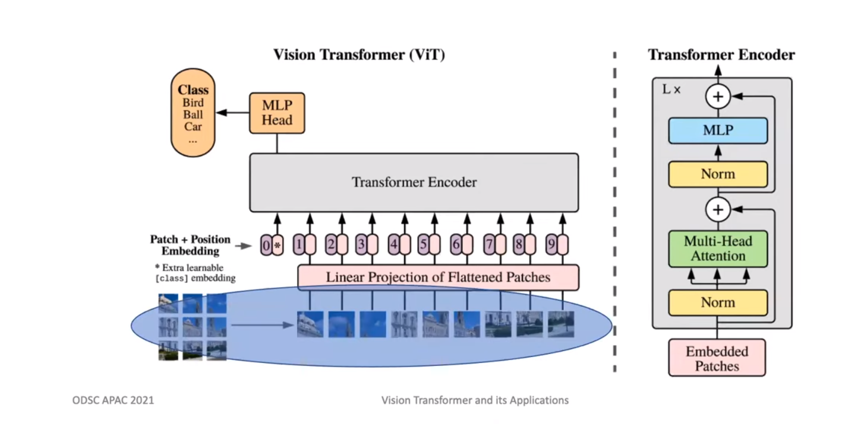
Vision transformer
A transformer can only process a sequence of tensors so we split the image into patches .
All patches are arranged in sequence from top left to bottom right.
After this we convert the patches into feature vectors using a process named linear projection.

Slide 14
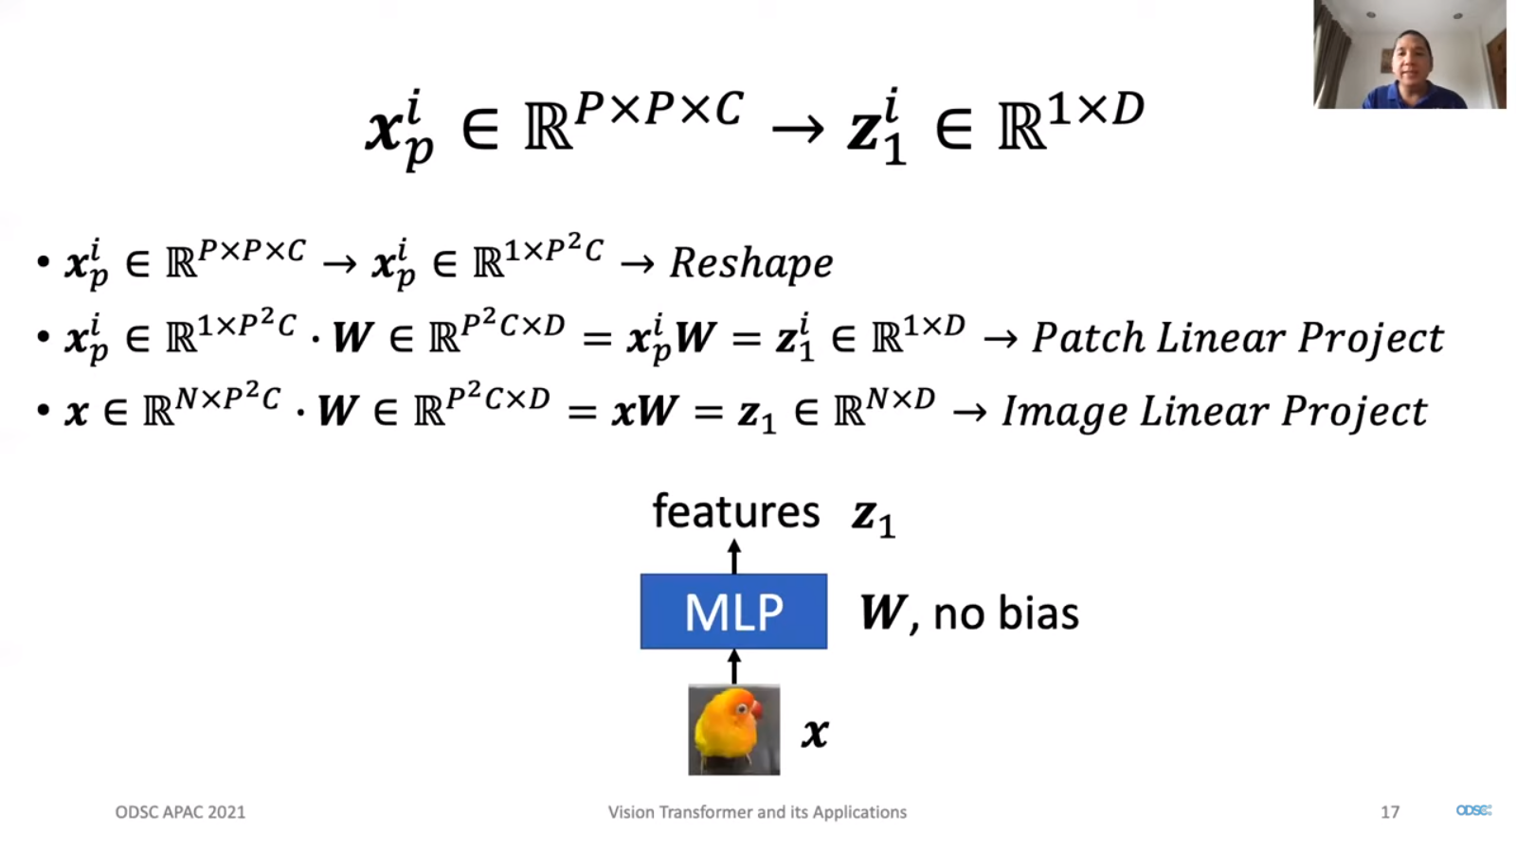
Linear Projection

Slide 15
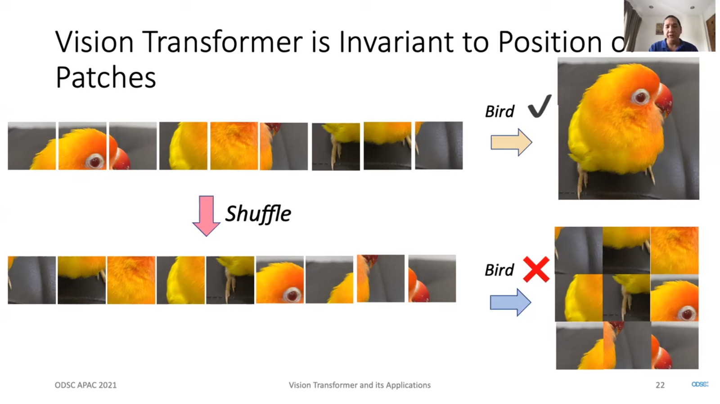
Why we need position embedding
Convolution is translation and scale equivariant
Pooling is translation and scale invariant

Slide 16
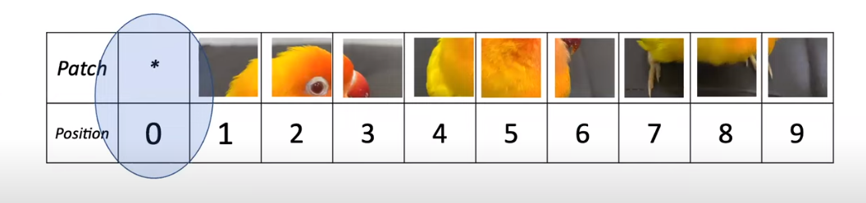
Class Embedding in Vision Transformers
At the beginning of the forward pass, a special token, often referred to as the "class token," is added to the sequence of image patch tokens. This class token does not represent any actual part of the image but serves as a placeholder or anchor for classification.

Slide 17
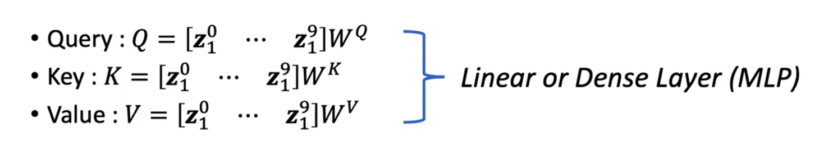
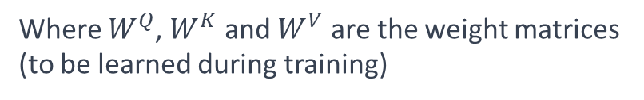
How we compute Queries, Keys, Vectors
The self-attention mechanism in the Transformer's encoder block requires Queries (Q), Keys (K), and Values (V).
Separate linear transformations (fully connected layers) are used to produce each of them.
Where $W^{Q}$​, $W^{K}$and $W^{V}$are the weight matrices (to be learned during training)

Slide 18
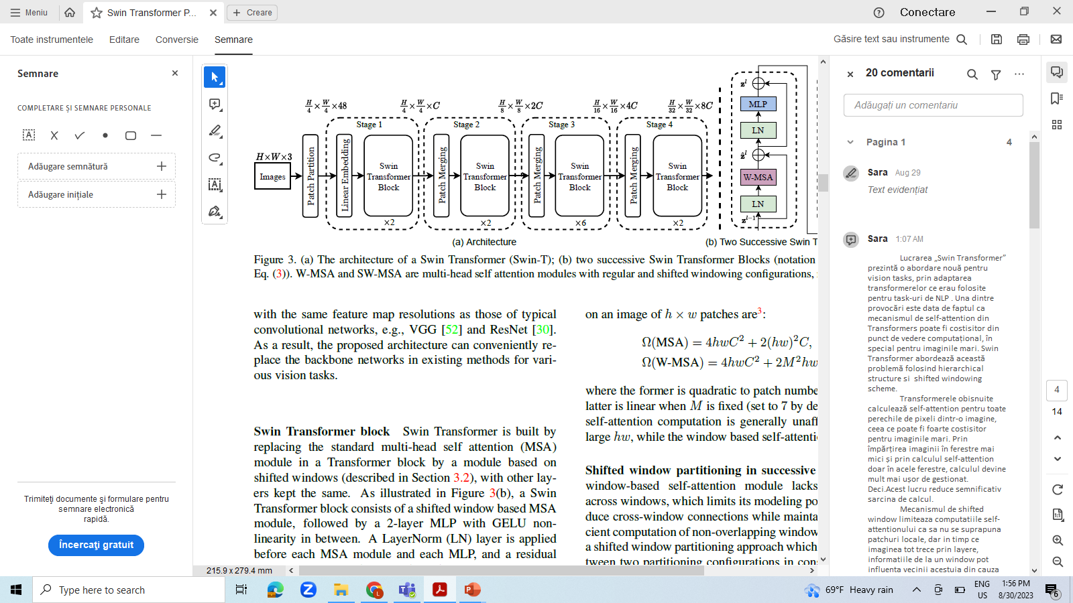
Overall Architecture of Swin Transformer
Composed of stages of patch merging and successive transformer blocks

Slide 19
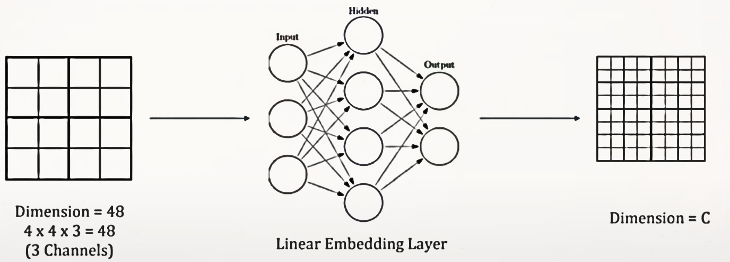
Patch partition and linear embedding

Slide 20
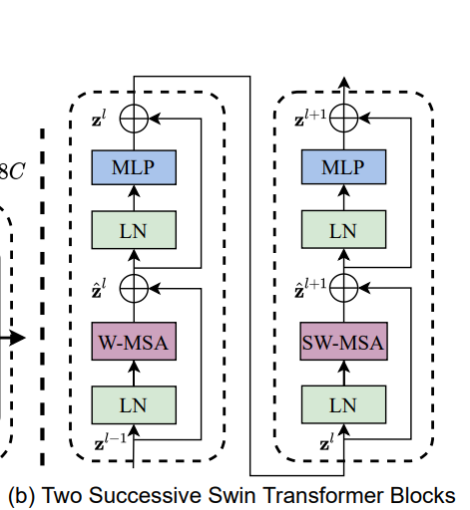
Swin Transformer Block
Swin Transformer block Swin Transformer is built by replacing the standard multi-head self attention (MSA) module in a Transformer block by a module based on shifted windows with other layers kept the same.
Swin Transformer block consists of a shifted window based MSAmodule, followed by a 2-layer MLP with GELU nonlinearity in between. A LayerNorm (LN) layer is applied before each MSA module and each MLP, and a residual connection is applied after each module.

Slide 21

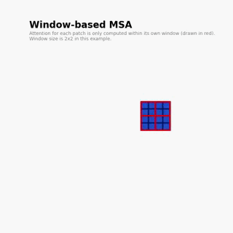
Why we use a Windows MSA instead of a standard MSA?

Slide 22
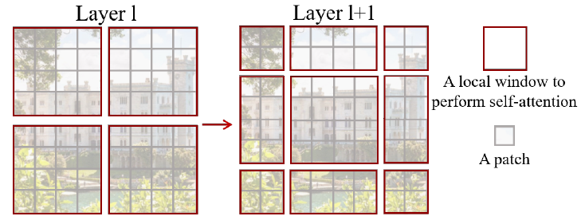
Shifted window approach
To overcome these issues, we propose a general purpose Transformer backbone, called Swin Transformer, which constructs hierarchical feature maps and has linear computational complexity to image size.
Swin Transformer constructs a hierarchical representation by starting from small-sized patches (outlined in gray) and gradually merging neighboring patches in deeper Transformer layers.
In layer l (left), a regular window partitioning scheme is adopted, and self-attention is computed within each window. In the next layer l + 1 (right), the window partitioning is shifted, resulting in new windows.

Slide 23
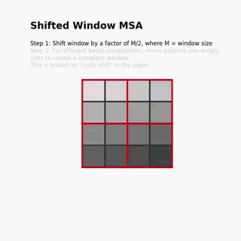
ShiftedWindow MSA

Slide 24
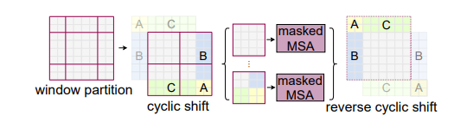
Efficient batch computation for shifted configuration
An issue with shifted window partitioning is that it will result in more windows, from [ h / M] × [ w / M ] to ([h/M] + 1) × ( [w/M ]+1) in the shifted configuration and some of the windows will be smaller than M × M.
A naive solution is to pad the smaller windows to a size of M × M and mask out the padded values when computing attention.
A more efficient batch computation approach by cyclic-shifting toward the top-left direction.

Slide 25
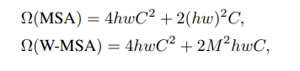
Supposing each window contains M × M patches, the computational complexity of a global MSA module and a window based one on an image of h × w patches are :
where the former is quadratic to patch number hw, and the latter is linear when M is fixed (set to 7 by default).

Slide 26
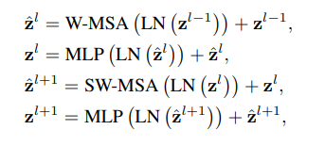
With the shifted window partitioning approach, consecutive Swin Transformer blocks are computed as

Slide 27
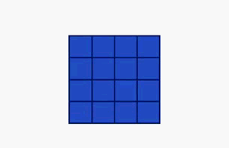
Patch Merging
The main idea is to progressively build feature maps with lower spatial resolution but higher semantic content as you go deeper into the network.
By merging patches, you reduce the spatial dimensions of the feature maps, making the network more computationally efficient.
Merging allows the network to capture higher-level abstractions by combining the learned features from adjacent patches.
H => H /n && W => W / n && C => n^2 *C

Slide 28
Architecture Variants
• Swin-T: C = 96, layer numbers = {2, 2, 6, 2}
• Swin-S: C = 96, layer numbers ={2, 2, 18, 2}
• Swin-B: C = 128, layer numbers ={2, 2, 18, 2}
• Swin-L: C = 192, layer numbers ={2, 2, 18, 2}

Slide 29
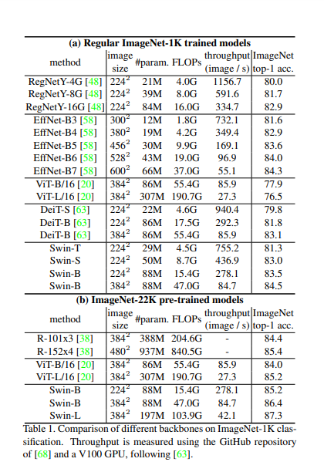
Image Classification on ImageNet-1K

Slide 30
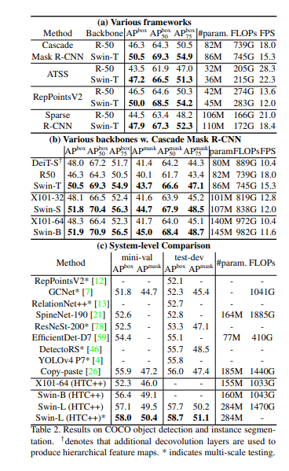
Object Detection on COCO

Slide 31

Semantic segmentation on the ADE20K

Slide 32

Conclusion
This paper presents Swin Transformer, a new vision Transformer which produces a hierarchical feature representation and has linear computational complexity with respect to input image size.
Swin Transformer achieves the state-of-the-art performance on COCO object detection and ADE20K semantic segmentation, significantly surpassing previous best methods.

Slide 33
Bibliografie
https://blog.csdn.net/weixin_40920183/article/details/125270483

